Slide 1
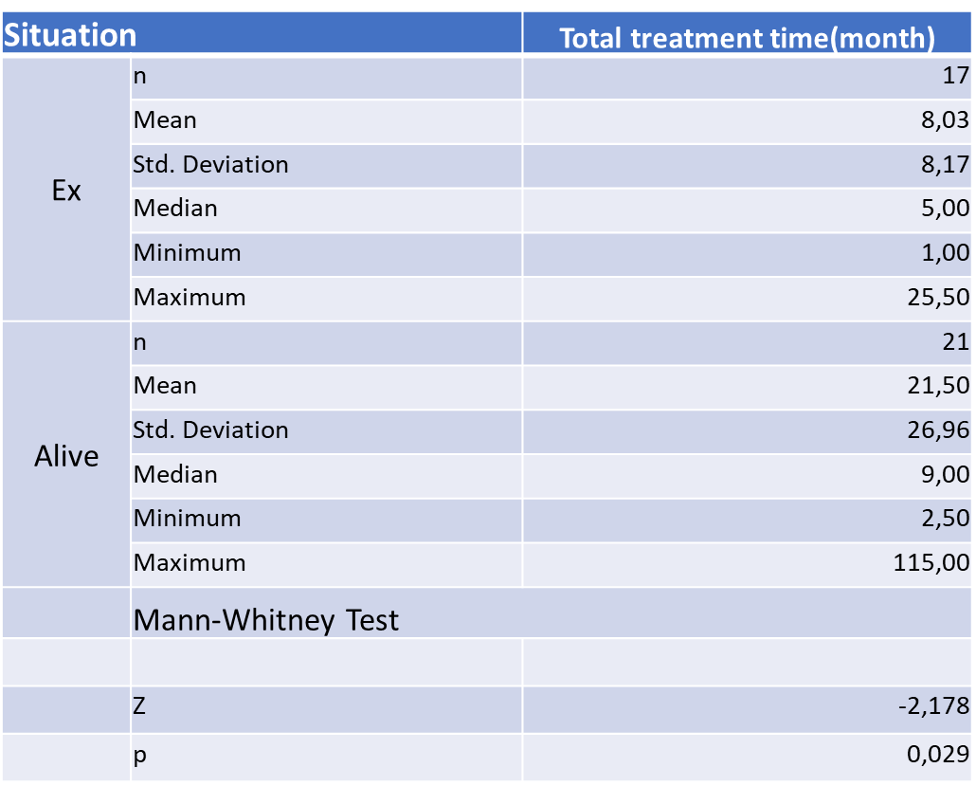
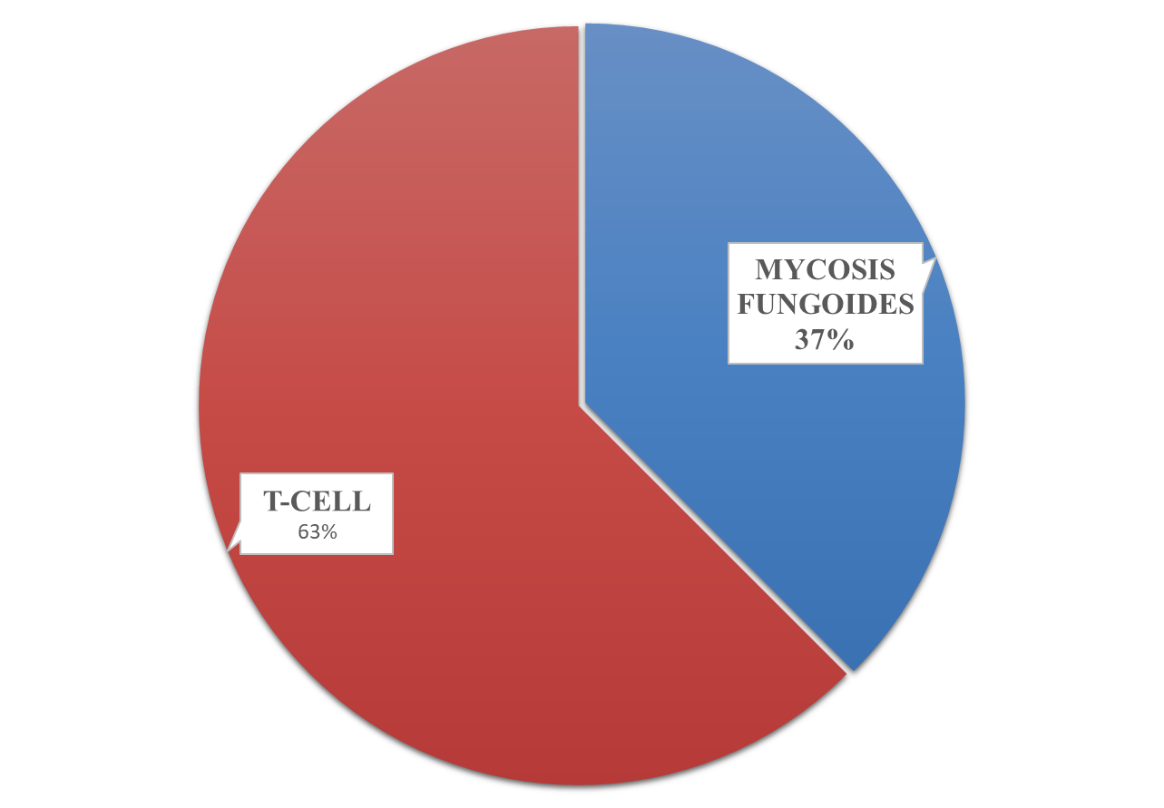
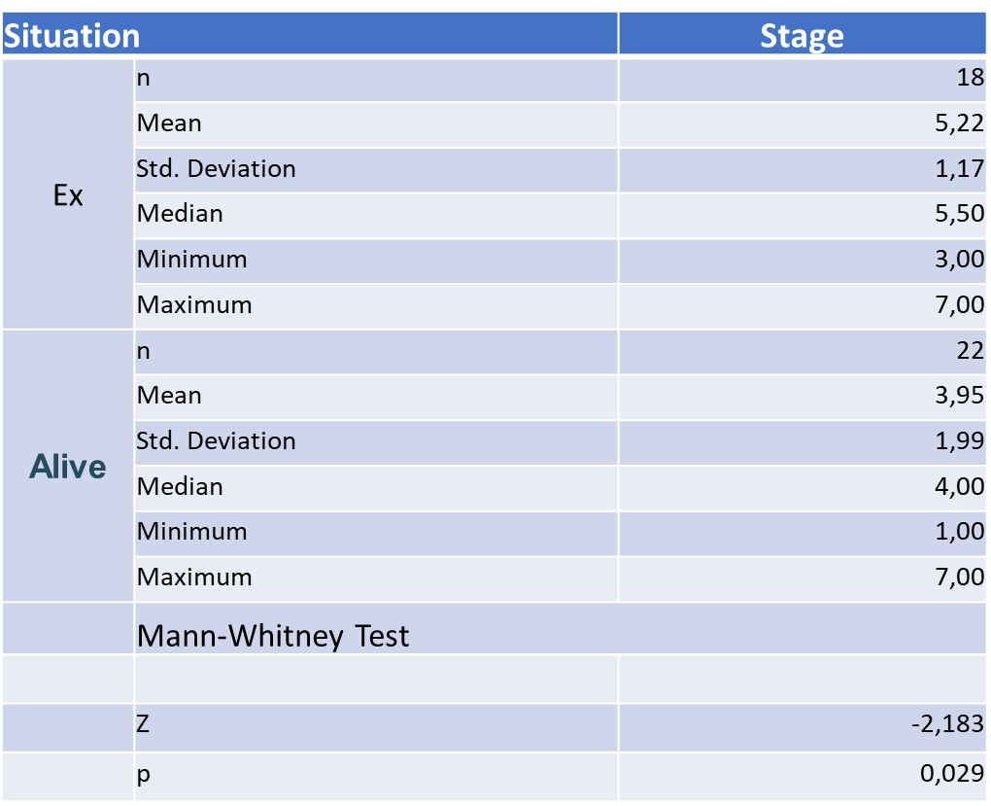
The Retrospective Analysis of Patients Diagnosed with T Cell Lymphoma at Bezmialem Vakif University’s School of Medicine Hospital
Ece Balcı¹ Güven Çetin²
¹Bezmialem Vakıf University Faculty of Medicine, İstanbul, Turkey
²Bezmialem Vakıf University Faculty of Medicine, Department of Internal Medicine, İstanbul, Turkey
Introduction
Lymphoma is an interesting disease in many ways. Lymphomas are tumoral formations that originate from lymphocytes. T-cell lymphomas are uncommon and aggressive malignancies associated with poor outcome. We aim to identify patients diagnosed with T-cell lymphoma to classify according to their stages, response to treatment, and to obtain a retrospective study.
Methods
Patients who presented to the Hematology clinic between 2011- July 2020 were included in the study. It was planned to reevaluate the patients with a retrospective study. Excel and SPSS were used in the data analysis. Patients diagnosed with Mycosis Fungoides, an indolent type of T-cell Lymphoma, were included in the study followed by the hematology clinic only.
Results
A total of 40 patients, 16 women and 24 men, were included in the study. The average age was 52,225. Of these patients, 15 had MF, 5 women and 10 men, 3 Anaplastic T-cell lymphoma 1 female and 2 male and 22 uncategorized T-cell lymphomas, 10 female and 12 male. Of patients, 1 was diagnosed as Stage 1A, 6 as 2A, 4 as 2B, 10 as 3A, 5 as 3B, 7 as 4A and 7 as 4B. During the study, 2 patients left the clinic, 17 patients died. The average age of patients died was 59,529. Of the patients, 11 were observed in remission, 2 of them went into remission on brentuximab. Bone marrow biopsy was performed in 32 patients and 10 patients were referred to an external center. While 7 of the 40 patients continue their treatment in our hematology clinic, 2 patients still continues at the external center.
 |  |  |  | situation |  | Total
 |  |  |  | Ex | Alive
Gender | Men | Men | n | 11 | 13 | 24
 |  |  | % | 45,8% | 54,2% | 100,0%
 | Women | Women | n | 7 | 9 | 16
 |  |  | % | 43,8% | 56,3% | 100,0%
Total |  |  | n | 18 | 22 | 40
 |  |  | % | 45,0% | 55,0% | 100,0%
 |  | Value | p
Pearson Chi-Square |  | 0,017 | 0,897 | NS
 |  |  |  | situation |  | Total
 |  |  |  | Ex | Alive
Diagnosis | T cell | T cell | n | 13 | 12 | 25
 |  |  | % | 52,0% | 48,0% | 100,0%
 | MF | MF | n | 5 | 10 | 15
 |  |  | % | 33,3% | 66,7% | 100,0%
Total |  |  | n | 18 | 22 | 40
 |  |  | % | 45,0% | 55,0% | 100,0%
 |  | Value | p
Pearson Chi-Square |  | 1,320 | 0,251 | NS
situation |  | n | average | standard deviation
Age | Ex | 18 | 58,78 | 18,22
 | Alive | 22 | 46,86 | 17,62
 |  | t-test for Equality of Means
 |  | t | p
Age |  | 2,095 | 0,043
According to gender, there was no significant difference in mortality if the total treatment time was ignored.
According to the diagnosis, there was no significant difference in mortality if the total treatment time was ignored.
The age average of the alive group is significantly higher than the ex-group.
The average total treatment time of the ex-group was statistically significantly higher than the alive group in terms of the median.
The average stage of the ex group was statistically significantly higher than the alive group in terms of the median.
Conclusion
T-cell lymphomas are a rare diseases that are still unknown. Even if the patients respond to the treatment, the response is poor with relapses. By expanding this study, it can be used as a basis for future research which can potentially be helpful for developing new approaches to this disease.
References
1. Kang, Danbee, et al. “Health-Related Quality of Life in Non-Hodgkin Lymphoma Survivors: A Prospective Cohort Study.” Cancer Research and Treatment, vol. 50, no. 4, 2018, pp. 1051–1063., doi:10.4143/crt.2017.207.
2. Phan, Anh, et al. “T-Cell Lymphoma Epidemiology: the Known and Unknown.” Current Hematologic Malignancy Reports, vol. 11, no. 6, 2016, pp. 492–503., doi:10.1007/s11899-016-0353-y.
3. Ma, Helen, and Maher Abdul-Hay. “T-Cell Lymphomas, a Challenging Disease: Types, Treatments, and Future.” International Journal of Clinical Oncology, vol. 22, no. 1, 2016, pp. 18–51., doi:10.1007/s10147-016-1045-2.

